Slide 1
Chapter 10 – Sociotechnical Systems
CSE 319
Software Engineering
Credit Hr. 3.00, Contact Hr. 3.00
Lec Tarannum Zaki
Dept of CSE
MIST

Slide 2
Topics covered
Sociotechnical systems
The sociotechnical systems stack
Complex systems
Organizational affects
Success criteria
Lifetime of sociotechnical systems

Slide 3
Systems
Software engineering is not an isolated activity but is part of a broader systems engineering process.
Software systems are therefore not isolated systems but are essential components of broader systems that have a human, social or organizational purpose.
Example:
Wilderness weather system is part of broader weather recording and forecasting systems.
These include hardware and software, forecasting processes, system users, the organizations that depend on weather forecasts, etc.
Notes:
The government of a country with large areas of wilderness decides to deploy several hundred weather stations in remote areas.

Slide 4
Sociotechnical systems
Sociotechnical refers to the interrelatedness of social and technical aspects of an organization.
A socio-technical system (STS) is one that considers requirements and interactions spanning hardware, software, personal, and community aspects.
It is socio technical as it represents an interaction between the technical domains of computer software and the human interaction.
It applies an understanding of the social structures, roles and rights (the social sciences) to inform the design of systems that involve communities of people and technology.
Examples of STSs include emails, blogs, and social media sites such as Facebook and Twitter.

Slide 5
Sociotechnical systems approach
A holistic approach to the design of engineering projects.
Takes into account the person, the technology, the moment, the environment, the physical space as well as human behavior and psychology.
Sociotechnical theory is about joint optimization approach.
Designing the social system and technical system jointly so that they work smoothly together.
Sociotechnical system is directed towards a meaningful design approach
It is not just job enlargement and enrichment which is important, but also transforming technology into a meaningful tool in the hands of the users.

Slide 6
Why sociotechnical systems?
Many people now acknowledge that systems which are developed using a socio-technical approach are more likely to be acceptable to end users and to deliver real value to stakeholders.
Socio technical approaches can help the design of organizational structures and business processes as well as technical systems.
There is a need to consider the ways that the social and technical aspects are interdependent and interact, which is central to the performance and behavior of STSs.

Slide 7
Complex systems
A system is a purposeful collection of inter-related components working together to achieve some common objective.
A system may include software, mechanical, electrical and electronic hardware and be operated by people.
System components are dependent on other system components.
The properties and behaviour of system components are inextricably inter-mingled. This leads to complexity.
Complex systems are usually hierarchical and so include other systems.

Slide 8
Complex system categories
Systems that include software fall into two categories:
Technical computer-based systems
Systems that include hardware and software but where the operators and operational processes are not normally considered to be part of the system. The system is not self-aware.
Example: A word processor used to write a book.
Socio-technical systems
Systems that include technical systems but also operational processes and people who use and interact with the technical system. Socio-technical systems are governed by organisational policies and rules.
Example: A publishing system to produce a book.

Slide 9
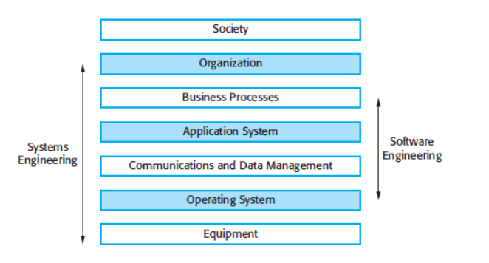
The sociotechnical systems stack
Sociotechnical systems are so complex that it is practically impossible to
understand them as a whole. Rather, it is viewed as layers:

Slide 10
Layers in the STS stack
Equipment
Hardware devices, some of which may be computers. Most devices will include an embedded system of some kind.
Operating system
Provides a set of common facilities for higher levels in the system.
Communications and data management
Middleware that provides access to remote systems and databases.
Application systems
Specific functionality to meet some organization requirements.

Slide 11
Layers in the STS stack
Business processes
A set of processes involving people and computer systems that support the activities of the business.
Organizations
Higher level strategic business activities that affect the operation of the system.
Society
Laws, regulation and culture that affect the operation of the system.

Slide 12
Organizational affects
When you are trying to develop sociotechnical systems, you need to understand the organizational environment in which they are used.
If you don’t, the systems may not meet business needs and users and their managers may reject the system.
Organizational factors from the system’s environment may affect the requirements, design, and operation of a sociotechnical system.

Slide 13
Organizational affects
Process changes
Systems may require changes to business processes so training may be required. Significant changes may be resisted by users.
Job changes
Systems may de-skill users or cause changes to the way they work. The status of individuals in an organization may be affected by the introduction of a new system.
Organizational changes
Systems may change the political power structure in an organization. If an organization depends on a system then those that control the system have more power.

Slide 14
Socio-technical system characteristics
Emergent properties
Non-deterministic
Complex relationships with organisational objectives

Slide 15
Socio-technical system characteristics
Emergent properties
They have emergent properties that are properties of the system as a whole, rather than associated with individual parts of the system.
Emergent properties depend on both the system components and the relationships between them.
Given this complexity, the emergent properties can only be evaluated once the system has been assembled.
Security and dependability are emergent system properties.

Slide 16
Socio-technical system characteristics
Non-deterministic
They are often nondeterministic. This means that when presented with a specific input, they may not always produce the same output.
The system’s behavior depends on the human operators and people do not always react in the same way.
Furthermore, use of the system may create new relationships between the system components and hence change its emergent behavior.
System faults and failures may therefore be transient, and people may disagree about whether or not a failure has actually occurred.

Slide 17
Socio-technical system characteristics
Complex relationships with organisational objectives
The extent to which the system supports organizational objectives does not just depend on the system itself.
It also depends on the stability of these objectives, the relationships, and conflicts between organizational objectives and how people in the organization interpret these objectives.
New management may reinterpret the organizational objectives that a system was designed to support so that a ‘successful’ system may then be seen as a ‘failure’.

Slide 18
Success criteria
Complex systems are developed to address ‘wicked problems’ – problems where there cannot be a complete specification.
Different stakeholders see the problem in different ways and each has a partial understanding of the issues affecting the system.
Consequently, different stakeholders have their own views about whether or not a system is ‘successful’
Success is a judgment and cannot be objectively measured.
Success is judged using the effectiveness of the system when deployed rather than judged against the original reasons.

Slide 19
Conflicting views of success
MHC-PMS is designed to support multiple, conflicting goals
Improve the quality of care for sufferers from mental illness.
Increase income by providing detailed reports of care provided and the costs of that care.
Fundamental conflict
To satisfy reporting goal, doctors and nurses had to provide additional information over and above that required for clinical purposes.
They had less time to interact with patients, so quality of care reduced. System was not a success.
However, managers had better reports
System was a success from a managerial perspective.

Slide 20
Lifetime of sociotechnical systems
Procurement (acquisition)
The purpose of the system is established, high-level system requirements are defined, decisions are made on how functionality is distributed and the system components are purchased.
Development
The system is developed – requirements are defined in detail, the system is implemented and tested and operational processes are defined.
Operation
The system is deployed and put into use. Changes are made as new requirements emerge. Eventually, the system is decommissioned.

Slide 21
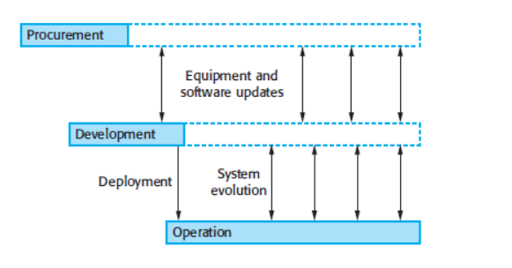
Lifetime of sociotechnical systems

Slide 22
Lifetime of sociotechnical systems
These stages are not independent.
Once the system is operational, new equipment and software may have to be procured to replace obsolete system components, to provide new functionality, or to cope with increased demand.
Similarly, requests for changes during operation require further system development.

Slide 23
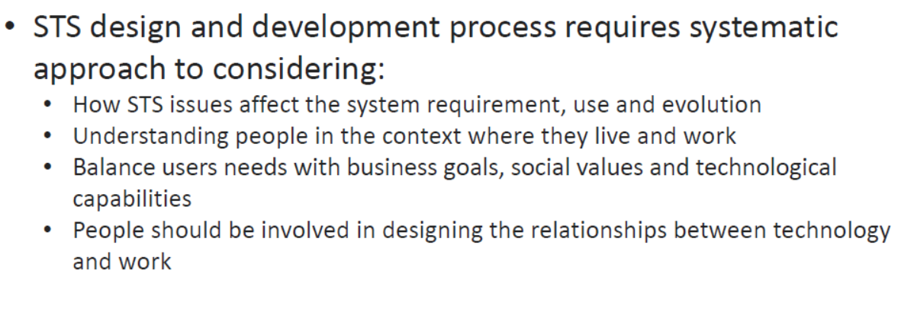
Designing STS - Considerations

Slide 24
Sociotechnical Systems - Example
Very relevant today in Healthcare organizations:
Healthcare organizations are very well suited for applying STS designs.
The functioning of hospitals mainly depends on the capabilities of its staff and employees.
Today most hospitals still use a "Scientific Management" approach in structuring their organization, which can easily be seen is one of the causes of the unsatisfactory functioning of hospitals.
Applying STS design principles can improve that significantly.

Slide 25
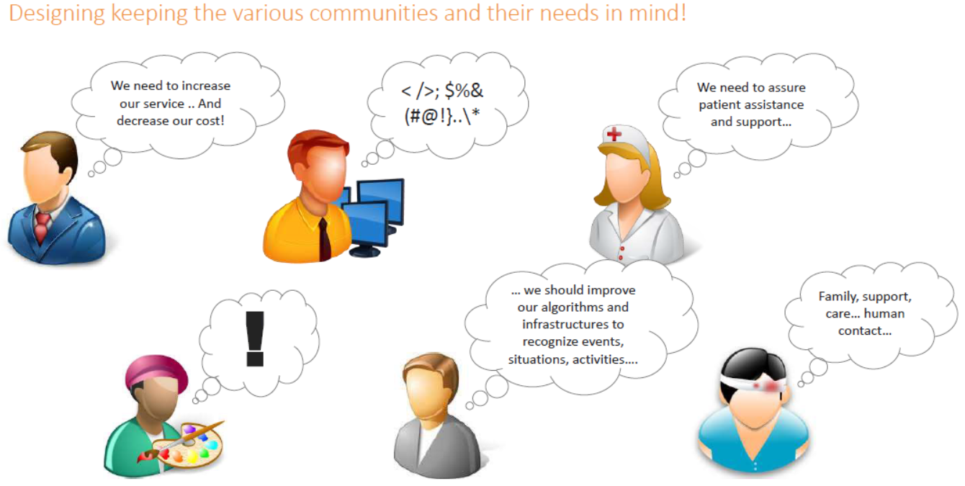
Sociotechnical Systems - Example

Slide 26
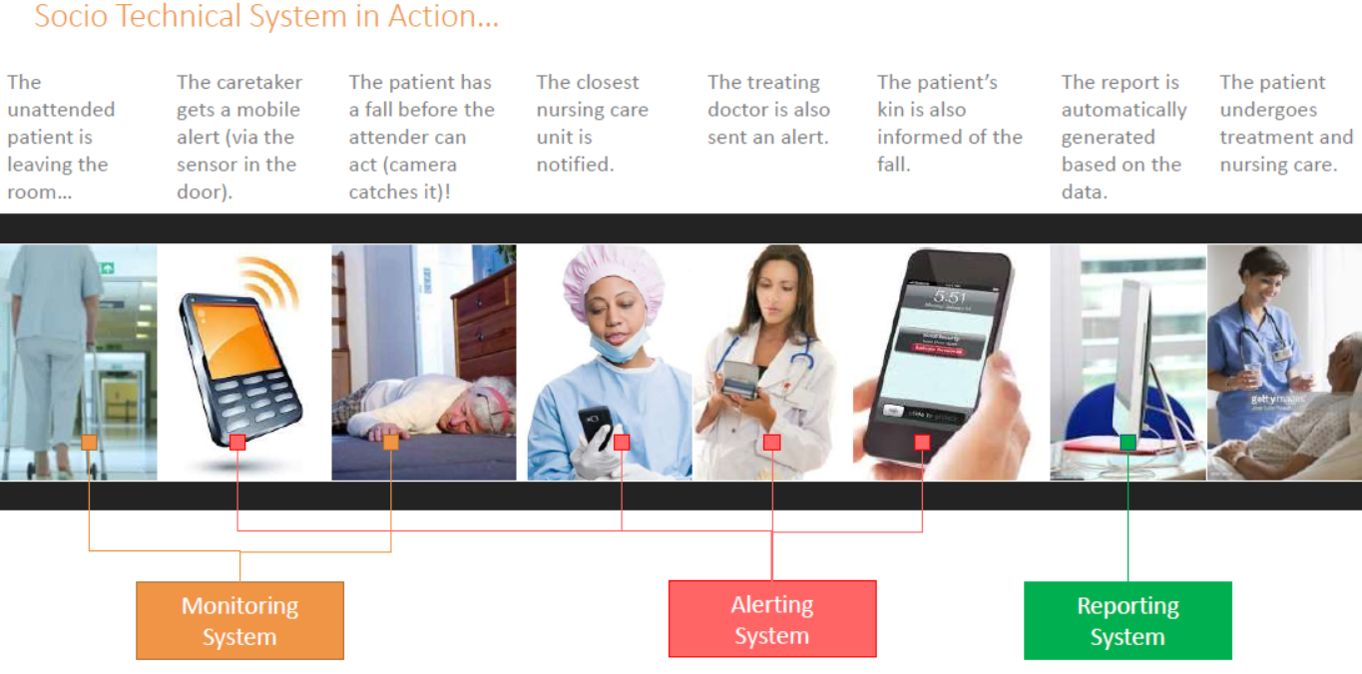
Sociotechnical Systems - Example

Slide 27
THANK YOU

